Slide 1
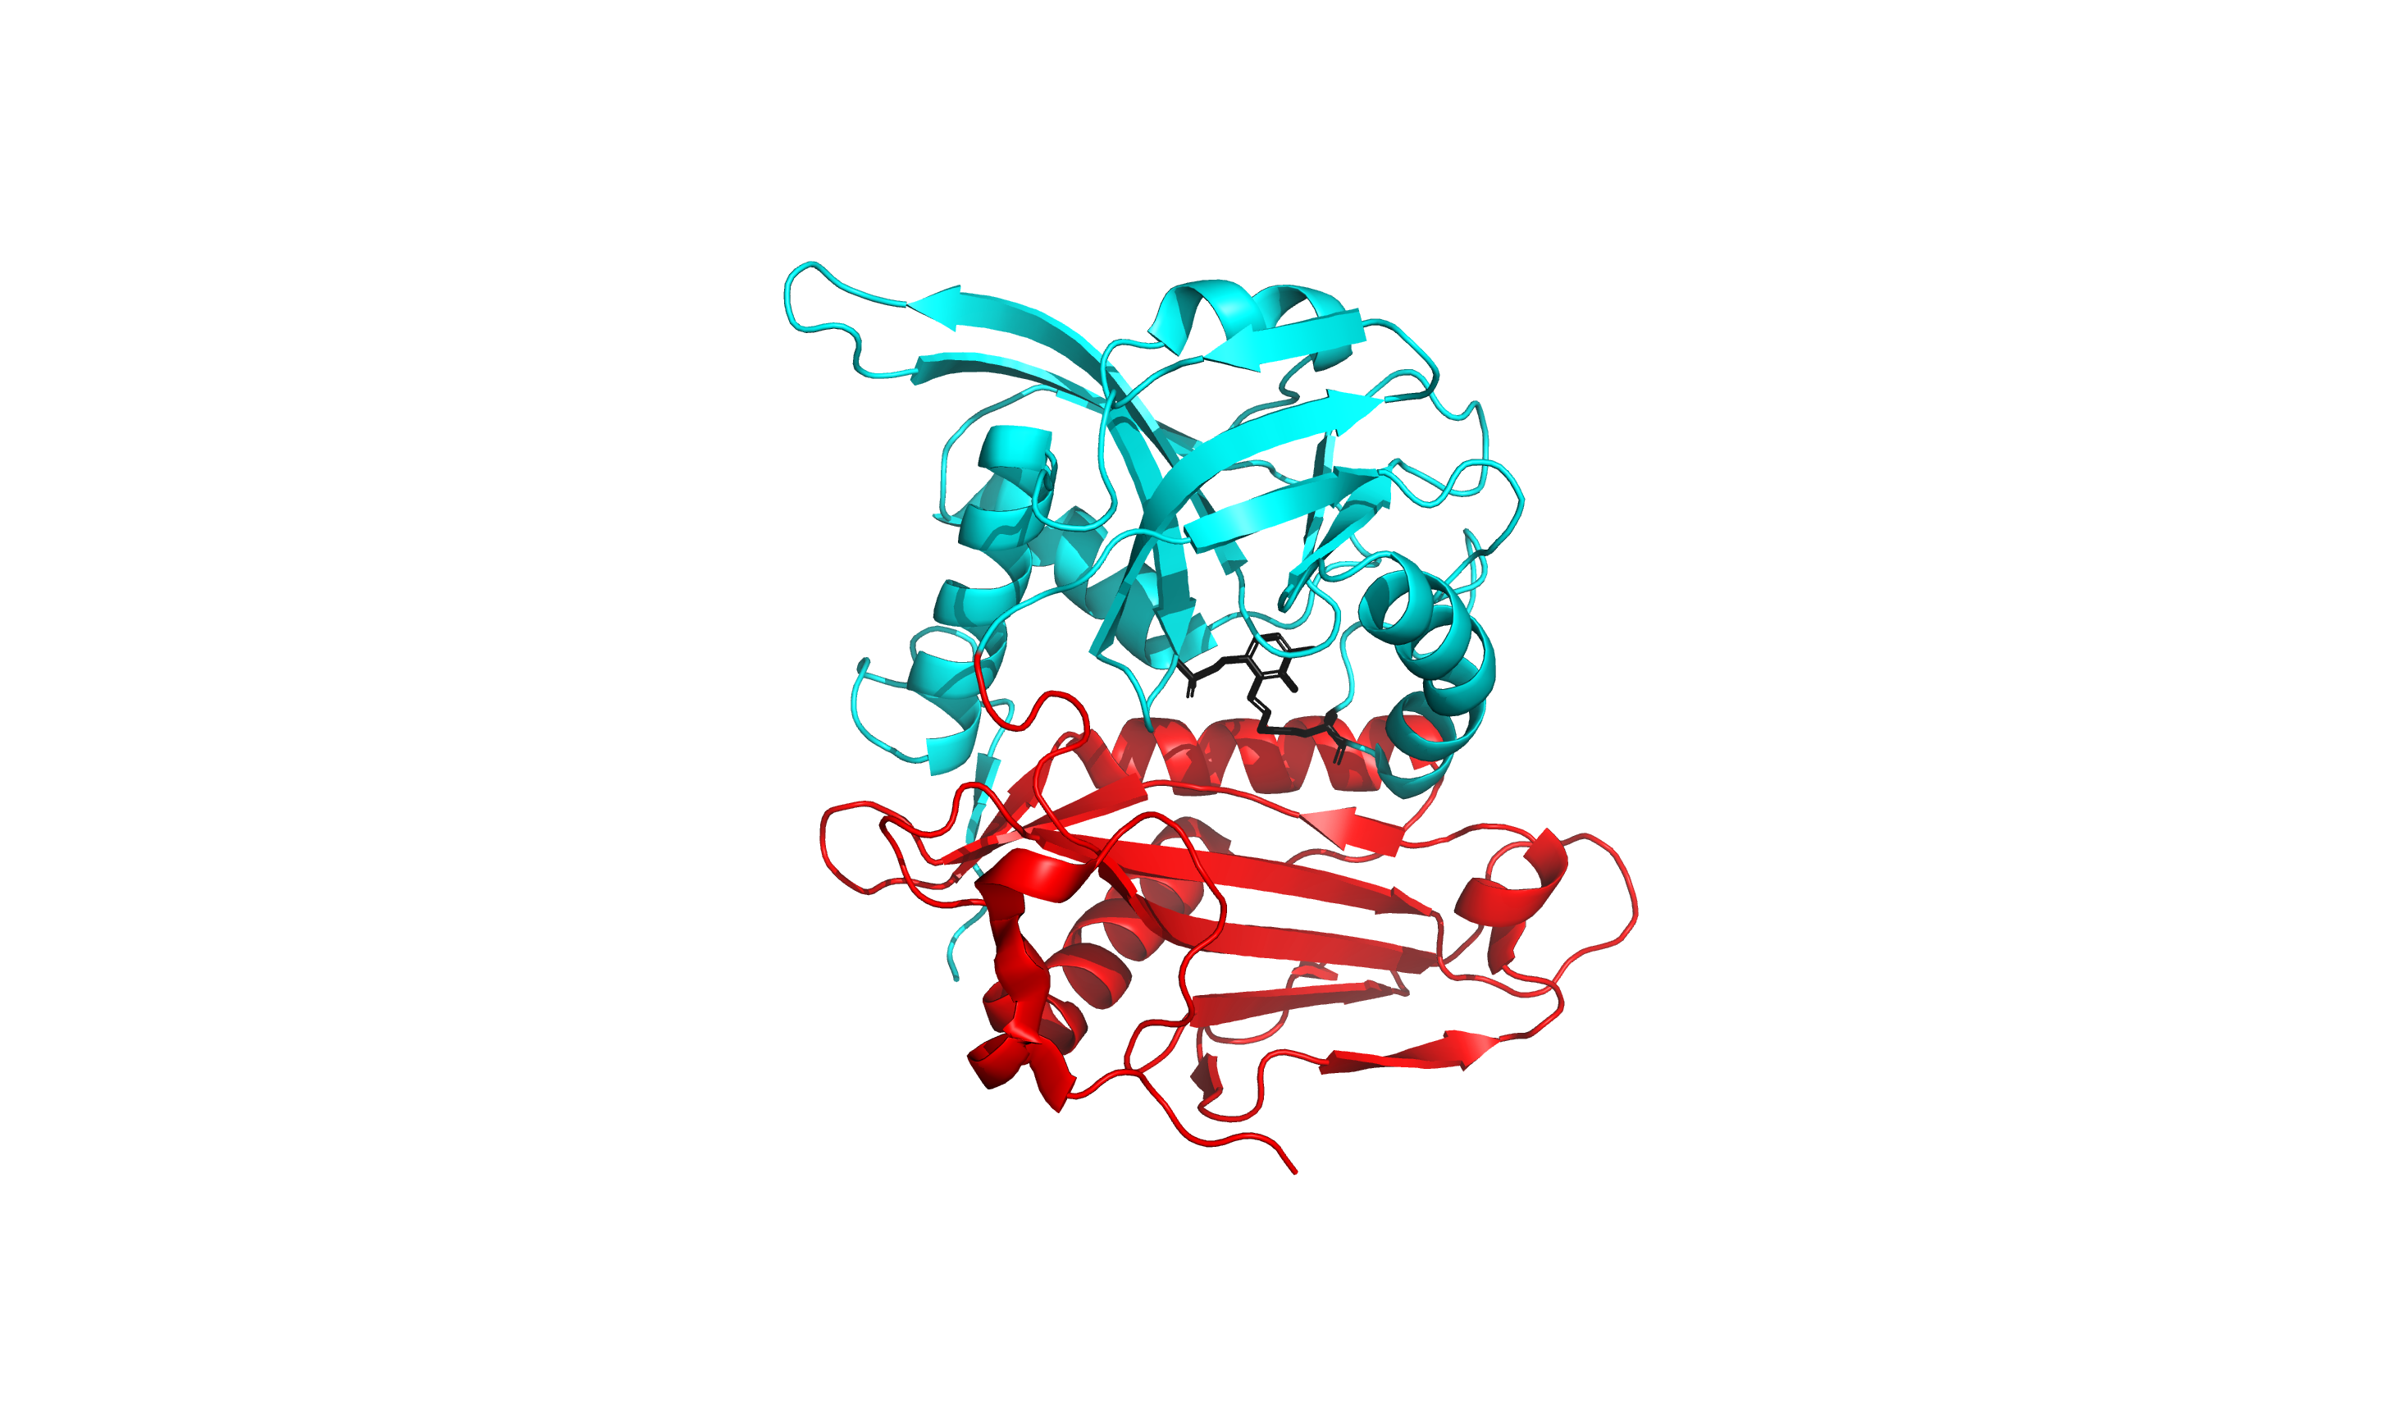
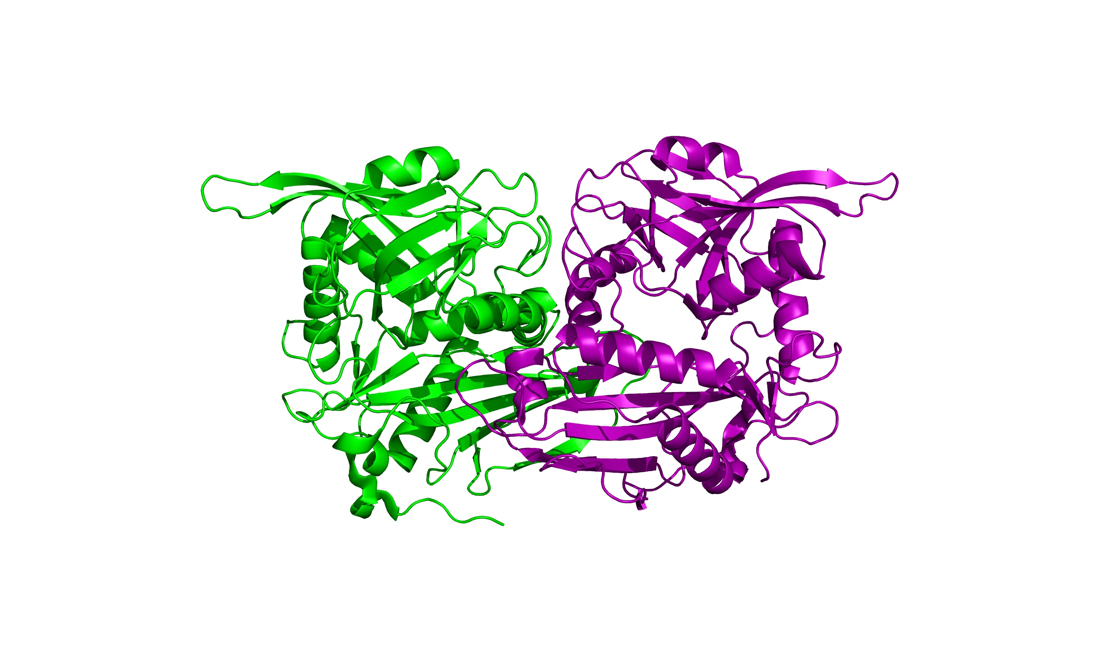
A.
B.
Monomer A
Monomer B
α-β Barrel Domain
LLP Modified Residue
2-Layer Sandwich Domain

